Slide 1
BREAST CANCER DETECTION WITH DENSENET ARCHITECTURE USING TRANSFER LEARNING
Team Members:
AASHIKA M – 810018205002
ELAKIYA R – 810018205021
Under the guidance of Dr. N. KATHIRVEL
Department of CSE,
UCE BIT Campus,
Anna University- Trichy.

Slide 2
ABSTRACT
To detect and classify the Breast cancer with DenseNet architecture using Transfer Learning.
The Dataset we use contains images (Histopathological images) from real life which are for both diseased and normal cases.

Slide 3
INTRODUCTION
Breast cancer - cells in the breast grow out of control.
Symptoms:
breast cancer include a lump in the breast
bloody discharge from the nipple and changes in the shape or texture of the nipple or breast
4 types of Breast Cancer
Ductal Carcinoma in situ
Invasive Ductal Carcinoma
Inflammatory Breast Cancer
Metastatic Breast Cancer

Slide 4
CNN(Convolutional Neural Network)
Feed Forward neural network
Composed of 6 types of layers
Input layer
Convolutional layer
Pooling layer
Fully connected layer
SoftMax/Logistic layer
Output layer

Slide 5
APPLICATION
Helpful tool for Physicians in clinical use.
Primary application for Pathology doctors.

Slide 6
LITERATURE SURVEY
SI NO | AUTHOR | TITLE | TECHNIQUE | LIMITATIONS
1 | Poonam Kathale Snehal Thorat | Breast Cancer Detection and classification | Random Forest | Lots of noise in final stage Not reliable
2 | Nur Syahmi Ismail Cheab Sovuthy | Breast Cancer Detection Based on Deep Learning Technique | ResNet50 VGG16 | Limited number of Dataset
3 | Siddhartha Gupta Neha Sinha Sudha R Challa Babu | Breast Cancer Detection Using Image Processing Techniques | K-means Clustering Edge Detection | Accuracy was not high

Slide 7
SI NO | AUTHOR | TITLE | TECHNIQUES | LIMITATIONS
4 | Naresh Khuriwal Dr Nidhi Mishra | Breast Cancer Diagnosis Using Deep Learning Algorithm | CNN SVM | Small number of Dataset
5 | Ziliang Zhong Muhang Zheng Huafeng Mai Jianan Zhao Xinyi Liu | Cancer Image Classification Based on DenseNet Model | DenseNet | Accuracy was not high
6 | Sangeetha R Dr Srikanta Murthy K | A Novel Aproach for Detection of Breast Cancer at an Early Stage Using Digital Image Processing Techniques | KNN Bayes Classifier Sobel Edge Detection | Removed parts of the breast
7 | Erwin Halim Pauline Phoebe Halim Marylise Hebrard | Artificial Intelligence Model for Breast Cancer Early Detection | Bayesian Method Classification | Limited number of dataset

Slide 8

PROPOSED SYSTEM
Normal
DenseNet201 with Transfer Learning
Preprocessing
Abnormal
Input image
Output
Fig 1: Proposed Block Diagram of Breast Cancer Classification

Slide 9
DENSENET201
Composed of Dense Blocks.
It has higher computational efficiency and memory efficiency.
More diversified features and tends to have richer patterns.

Slide 10
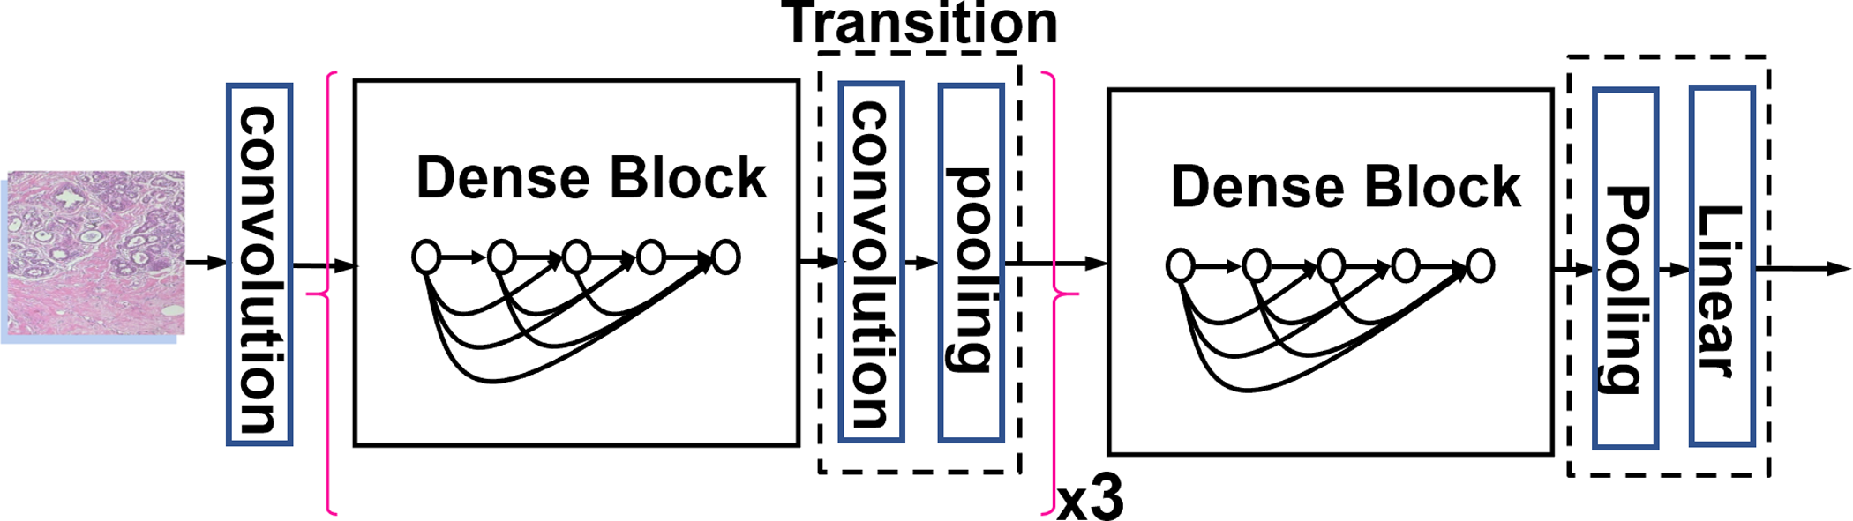
DIAGRAM

Slide 11
DENSENET ADVANTAGES
Parameter Efficiency
Implicit deep Supervision

Slide 12
TRANSFER LEARNING
It is a popular approach in deep learning where pre-trained models are used as the starting point.
Build a Transfer Learning model:
1. Obtain Pre-trained model.
2. Create a Base model.
3. Freeze layers.
4. Add new trainable layers.
5. Train the new layers.
6. Fine-tune your model.

Slide 13
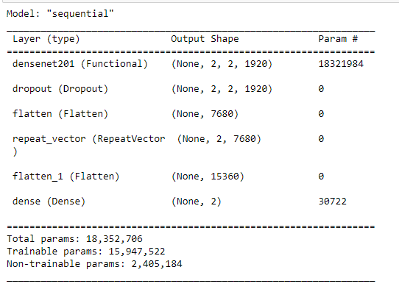
PARAMETERS USED

Slide 14
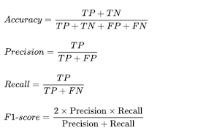
METRICS

Slide 15
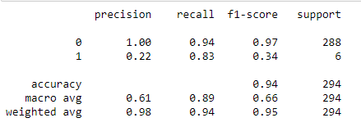
EXPERIMENTAL RESULTS

Slide 16
TRAINING
SI NO | NO OF LAYERS FROZEN | TRAINING ACCURACY | VALIDATION ACCURACY
1 | 200 | 0.9710 | 0.9796
2 | 199 | 0.9606 | 0.9796
3 | Complete Freezing | 0.9723 | 0.9796

Slide 17
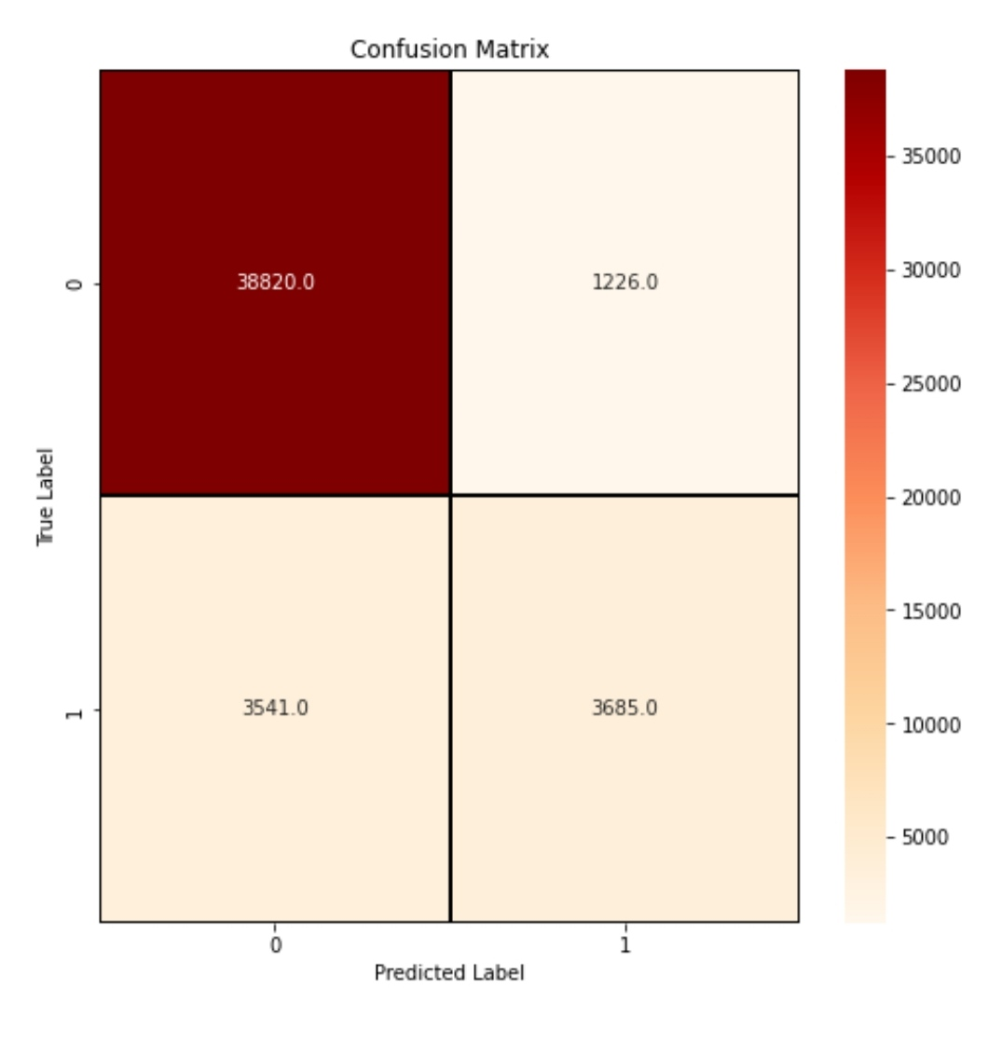
TESTING

Slide 18






OUTCOMES
a
b
c
d
e
f
Sample image taken from histopathological dataset

Slide 19
Original Normal
Predicted as Normal
Original Normal
Predicted as Normal
Original Normal
Predicted as Abnormal
Original Abnormal
Predicted as Abnormal
Original Abnormal
Predicted as Abnormal
Original Abnormal
Predicted as Normal

Slide 20
FUTURE WORK
Hand-held Ultra Sonography
Automated breast ultrasound

Slide 21
CONCLUSION
With the help of CNN, it is more efficient to detect most areas of cancer except for some areas that are too difficult to distinguish.
Our model has the best Accuracy value relative to the other models.

Slide 22
REFERENCES
[1]Poonam Kathale, Snehal Thorat (2020). “Breast Cancer Classification and Detection”. In the 2020 IEEE 1 2020 International Conference on Emerging Trends in Information Technology and Engineering (ic - ETITE).
[2]Nur Syahmi Ismail, Cheab Sovuthy (2020). “Breast Cancer Detection Based on Deep Learning Technique”. In the 2019 International UNIMAS STEM 12th Engineering Conference (EnCon).
[3]Siddhartha Gupta, Neha Sinha, Sudha R, Challa Babu (2020). “Breast Cancer Detection Using Image Processing Techniques”. In the 2019 Innovations in Power and Advanced Computing Technologies (i-PACT).

Slide 23
[4]Naresh Khuriwal, Dr Nidhi Mishra. “Breast Cancer Diagnosis Using Deep Learning Algorithm”. In the International Conference on Advances in Computing, Communication Control and Networking (ICACCCN2018).
[5]Ziliang Zhong, Muhang Zheng, Huafeng Mai, Jianan Zhao, Xinyi Liu. “Cancer Image Classification Based on DenseNet Model”. In the Journal of Physics: Conference Series 1651 (2020) 012143.
[6] Sangeetha R, Dr. Srikantha Murthy k(2017), “ A Novel Approach for Detection of Breast Cancer at an early stage using Digital Image Processing techniques”. In the 2017 International Conference on Inventive Systems and Control.
[7] Erwin Halim, Pauline Phoebe Halim,” Artificial Intelligent Models for Breast Cancer Early Detection ”

Slide 24
THANK YOU

